Slide 1
The Vision for Sport in Wales
Applying the Wellbeing of Future Generations (Wales) Act 2015
A presentation to demonstrate;
How application of the sustainable development principle has shaped the Vision for Sport in Wales.
How the Vision can drive sustainable development and delivery against national wellbeing goals.

Slide 2
The Well-being of Future Generations (Wales) Act is a ground-breaking piece of legislation that requires public bodies in Wales to work better with others (including each other and communities) and take a more joined up, long-term approach so that their decisions have a positive impact on people living in the future as well as those living today.
Notes:
Wales faces some significant challenges in providing a decent quality of life for all its citizens and in ensuring that the same living standards will also be available to future generations. These challenges include an ageing population, pockets of generational economic inactivity, health inequalities, poverty and a shrinking public purse. We also face the local consequences of global threats such as climate change, biodiversity loss and the impacts of a globalised economy.
The thinking behind the Act recognises that, to overcome these challenges, public bodies and government need to work in a different way – a way that will:
• consider all aspects of well-being in decision making - cultural, social, environmental and economic
• help public bodies, businesses and communities cooperate more effectively to draw out the amazing wealth of expertise and knowledge that is available
• recognise and respect the limits of our natural environment and

Slide 3
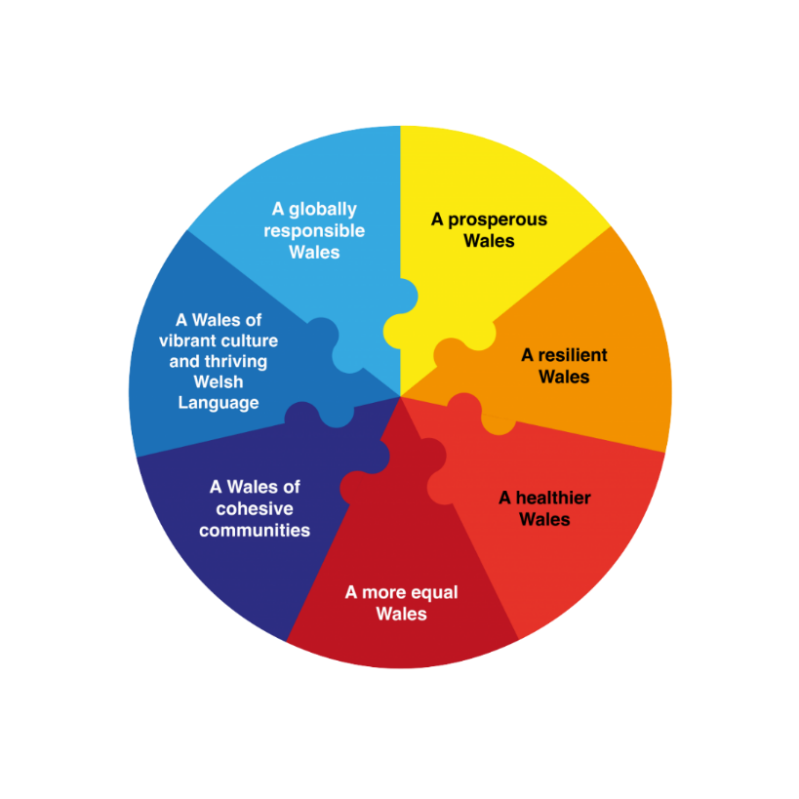
The Act sets out 7 goals that provide a common vision for public bodies to work towards.

Slide 4
Goal
A prosperous Wales | An innovative, productive and low carbon society which recognises the limits of the global environment and therefore uses resources efficiently and proportionately (including acting on climate change); and which develops a skilled and well educated population in an economy which generates wealth and provides employment opportunities, allowing people to take advantage of the wealth generated through securing decent work.
A resilient Wales | A nation which maintains and enhances a biodiverse natural environment with healthy functioning ecosystems that support social, economic, and ecological resilience and the capacity to adapt to change (e.g. climate change).
A healthier Wales | A society in which people’s physical and mental well-being in maximised and in which choices and behaviours that benefit future health are understood.
A more equal Wales | A society which enables people to fulfil their potential no matter what their circumstance or background. (Including socio economic background and circumstances)
A Wales of Cohesive Communities | Attractive, viable, safe and well-connected communities.
A Wales of vibrant culture and thriving Welsh Language | A society that promotes and protects culture, heritage and the Welsh language, and which encourages people to participate in the arts, and sport and recreation.
A globally responsible Wales | A nation which, when doing anything to improve the economic, social, environmental and cultural well-being of Wales, takes account of whether doing such a thing may make a positive contribution to global well-being.

Slide 5





Sustainable Development
‘To meet the needs of the present without compromising the ability of future generations to meet their needs.’
Public bodies should demonstrate that they have applied the 5 ways of working

Slide 6
The 5 Ways of Working
Prevention – acting to prevent problems getting worse or from starting in the first place.
Thinking for the long-term – thinking about long-term needs and demands as well as current ones.
Integration – considering how actions in one area may impact on other areas.
Collaboration – Working with others – including third sector bodies and communities - to help achieve goals that have been decided together.
Involvement – involving the people that services or activities are going to benefit or affect from as early a stage as possible.

Slide 7
The Vision for Sport in Wales
How the 5 ways of working have been applied

Slide 10
Examples of how the Vision for Sport in Wales can contribute to the 7 Goals

Slide 12
Provision of
sport and recreation opportunities for all ages throughout life.
Unleashing
the benefits of sport for health issues including mental health.
Opportunities that meet demands of changing lifestyles through
collaboration
and co
-
production with citizens.
Employers creating active workplaces internally and through the land around them e.g., the use of showers, bike racks,
flexible working to promote participation in sport and recreation.
Sport providers and employers
under
standing the importance of
well
-
A H
ealthier Wales
being and recognising mental health.
Sport and recreation environments offering healthy food options.
Education and community centres opening assets for sports activity
-
creating health benefits for the local community.
Social
l prescribing.
Increased
opportunities for families.

Slide 16
The Vision for Sport in Wales
How the Vision can drive sustainable development.

